Slide 1


SQL PROJECT
DATABASE FOR COMPANY
Under Supervisior
ENG: Hazzam Omar
Abdullah Ibrahim Mahmoud
Belal Abdelraouf Marey
Ziad Abdelader
Omar Samir

Slide 2

TOPICS
INTRO
CREATE TABLE
ADD CONSTRAIN
EACH TABLE IN DATA BASE
ANSWERS OF TACK
I 1

Slide 3
Introduction
The goal
Create a company database with multiple interrelated tables. Each group is responsible for creating specific tables and populating them with data. Once all data is in place, groups will then establish relationships and constraints using ALTER and UPDATE statements.
I 2

Slide 4
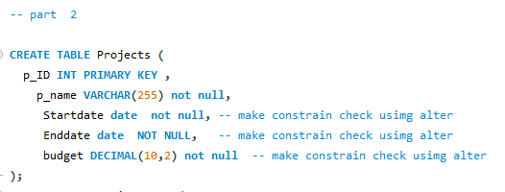
Create Tables
I 3

Slide 5
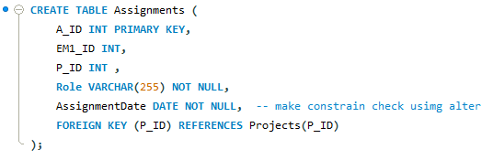
Create Tables
I 4

Slide 6
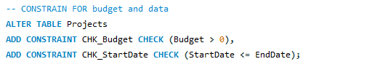

Constrains
I 5

Slide 7
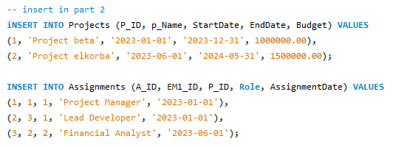


EACH TABLE IN DATA BASE
Insert Data
Each Table
I 6

Slide 8
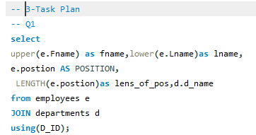
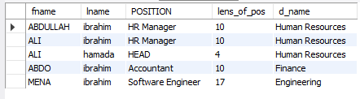
ANSWERS Question
Q1
I 7

Slide 9
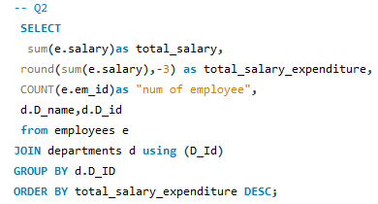
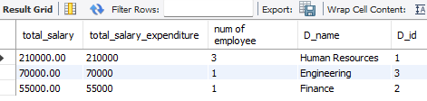
ANSWERS Question
Q2
I 8

Slide 10
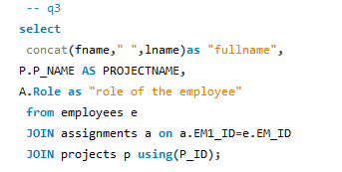

ANSWERS Question
Q3
I 9

Slide 11
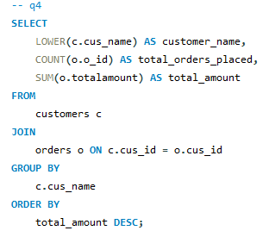

ANSWERS Question
Q4
I 10

Slide 12
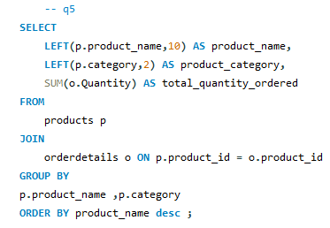

ANSWERS Question
Q5
I 11

Slide 13
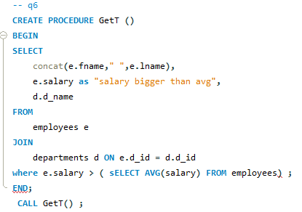

ANSWERS Question
Q6
I 12

Slide 14
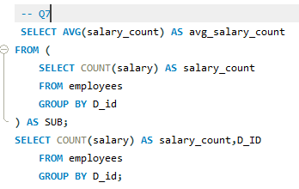


ANSWERS Question
Q7
I 13

Slide 15
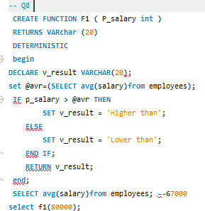

ANSWERS Question
Q8
I 14

Slide 16
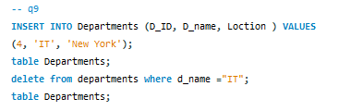
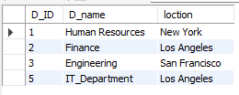
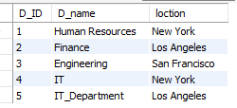
ANSWERS Question
Q9
I 15

Slide 17
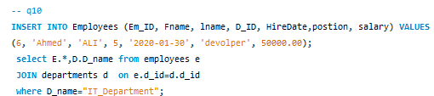


ANSWERS Question
Q10
I 16

